Slide 1
Group F Milestone 1 Presentation
Andrew Ashley, Nur Iren, Sean McHale, Nayana Suvarna
Notes:
Introduce group

Slide 2


Project Goals
We predict that we can identify a correlation between overall sentiment in tweets and case count trends at different US cities by comparing sentiment in COVID-19 related tweets in the US to COVID-19 case data
We plan to build an application that leverages the model will scrape tweets related to Covid-19 from twitter, and then attempt to locate and display possible new Covid-19 hotspots
+
Notes:
Relevance to current issues + objective of project
Uncertain about application ---> will help predict hotspots

Slide 3
Datasets

Slide 4
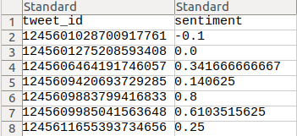
Geo-tagged Tweet Dataset
Tweet ID:
Each tweet is mapped to a unique key
Lookup of the key provides a JSON file with information about the tweets
Sentiment:
Score from sentiment analysis
Expressed on scale of [-1, 1]
https://ieee-dataport.org/open-access/coronavirus-covid-19-geo-tagged-tweets-dataset

Slide 5
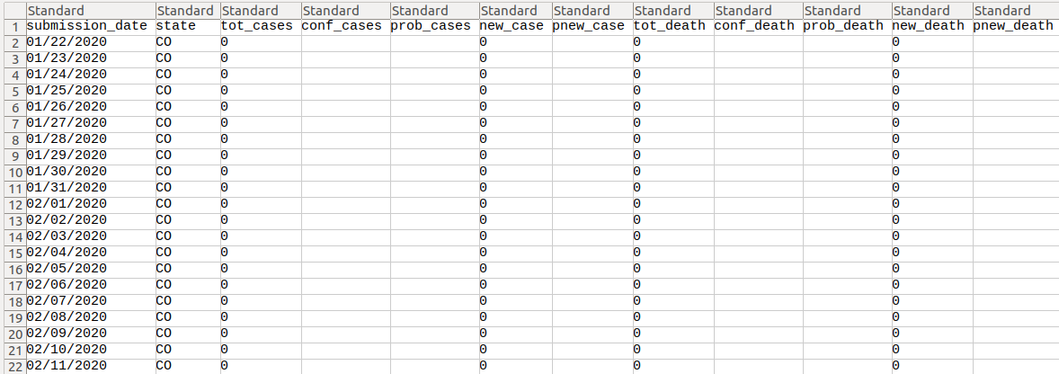
US Covid-19 Cases and Deaths by State
https://healthdata.gov/dataset/united-states-covid-19-cases-and-deaths-state-over-time
Notes:
Figure out through training which metric is best

Slide 6
Sentiment Analysis

Slide 7


Sentiment Analysis Explained
Most COVID-19 data sets focus on objective data about the virus. We wanted to try a more subjective approach and see how people’s outlook about the virus correlated to its spread
Our dataset used a Python library called TextBlob to perform natural language processing and determine the sentiment of each tweet
This sentiment is returned as
a value from [-1,1] denoting the
“polarity” of a tweet

Slide 8
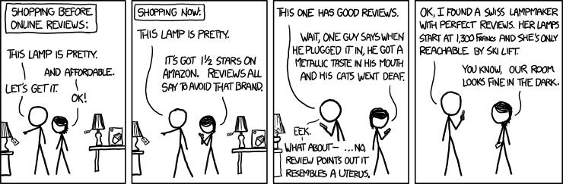
Polarity
We are using the polarity value from sentiment analysis as a measure of people’s attitude towards COVID
  A high polarity (close to 1) means that a person’s tweet has a positive outlook on COVID-19
  A medium polarity (close to 0) means the person tweet has a neutral outlook on COVID-19
  A low polarity (close to -1) means the the person’s tweet has a negative outlook on COVID-19

Slide 9
Data Analysis

Slide 10
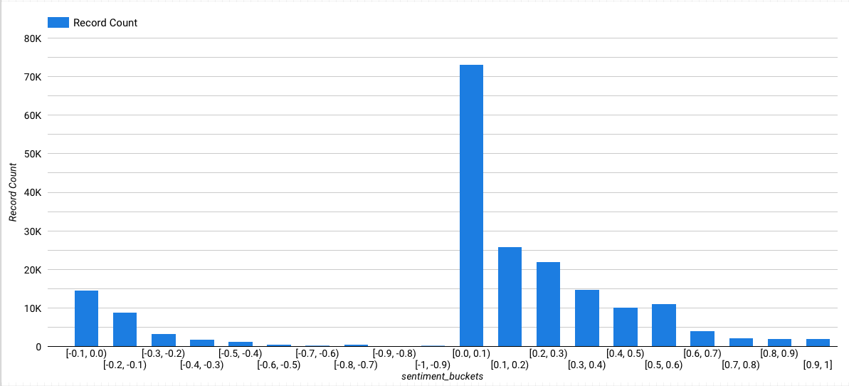
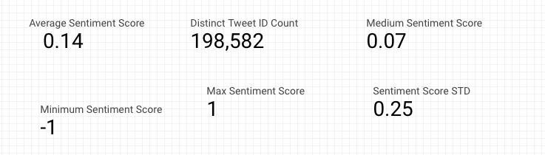
Overall Behavior of Sentiment Analysis
Tweets from April 1st - August 31st

Slide 11
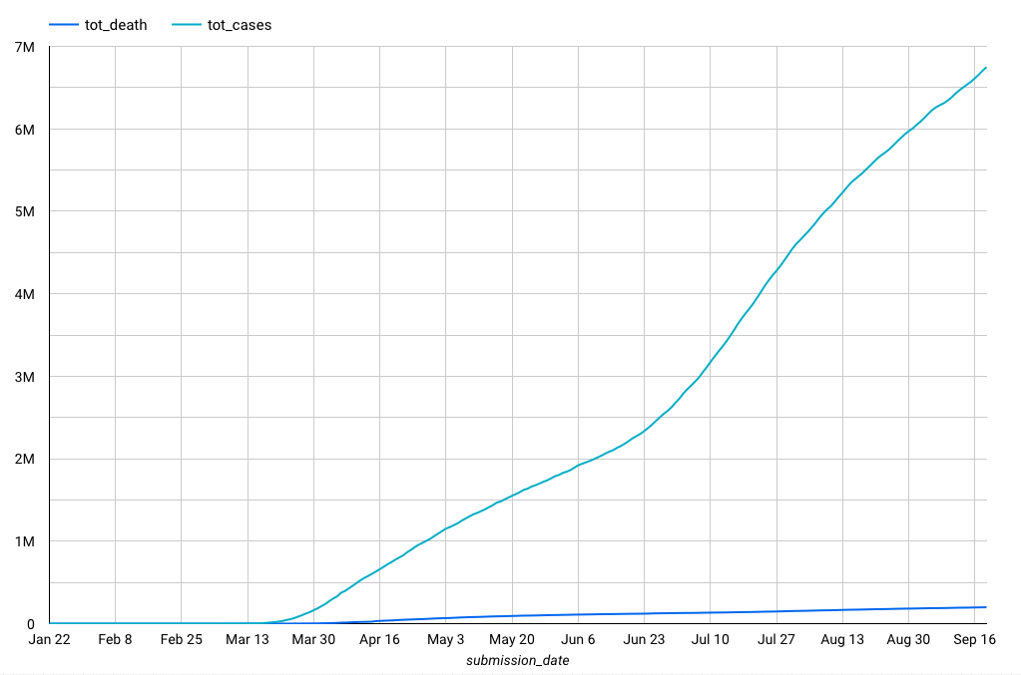
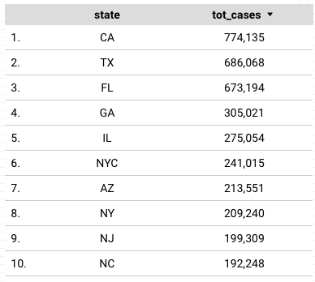
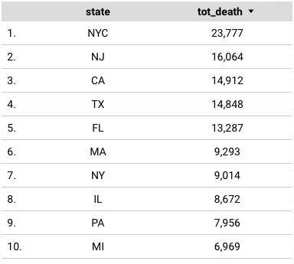
COVID Overall Deaths & Overall Cases

Slide 12
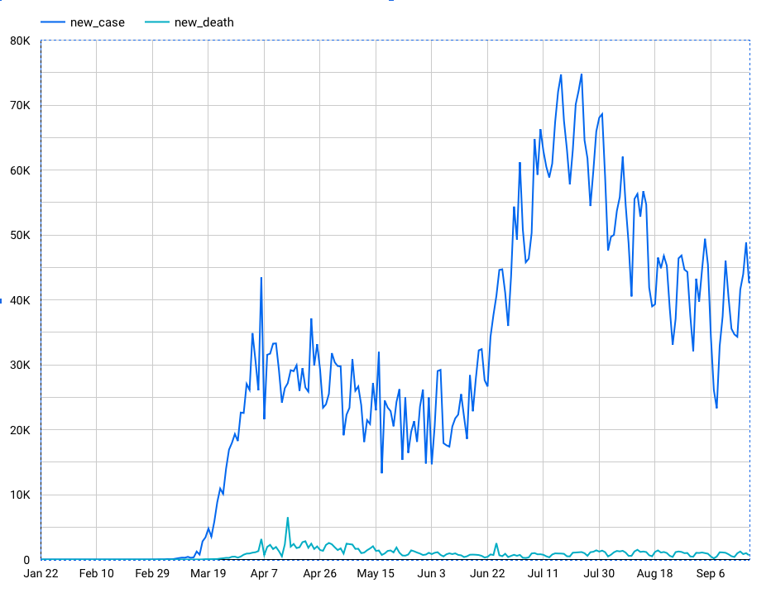
New COVID Cases and New Deaths
Notes:
New cases and new deaths
States with the highest total cases
States with the highest total deaths

Slide 13
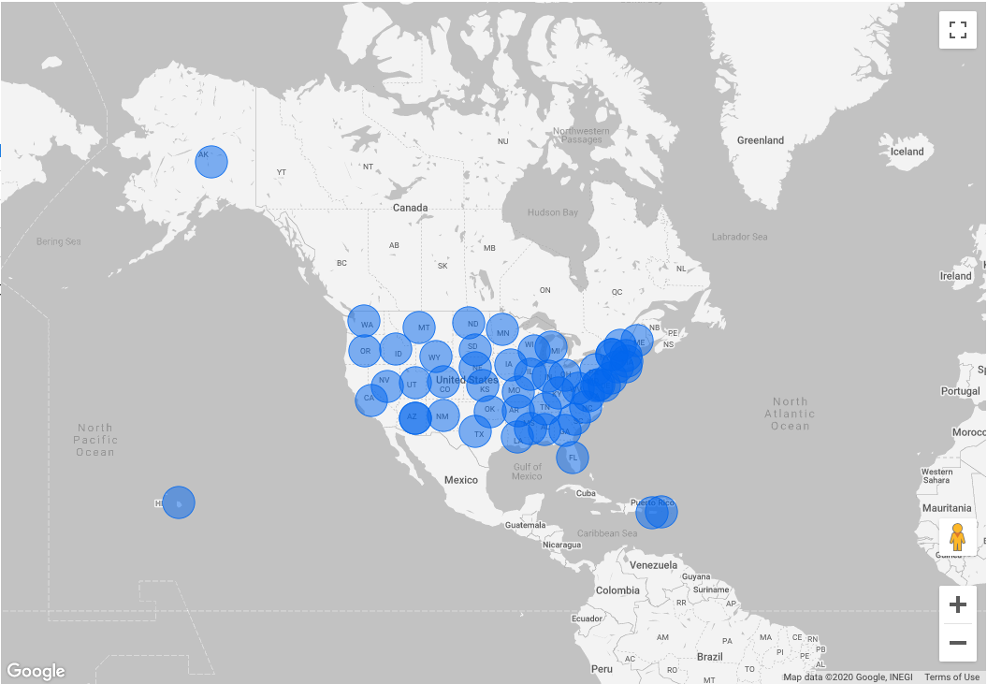
Cases Across the United States

Slide 14
Progress and Next Steps

Slide 15
Progress
-Gathered data
-Merged data from the multiple sources into one dataset
-Data gathered was evaluated for completeness and validity
-Part of data was cleaned
- Applied for Twitter Developer accounts to gain access to Twitter API

Slide 16
Next Steps
Waiting for approval of twitter development accounts
  Will allow us to retrieve information on tweets by hydrating tweet IDs
  Analyze and group tweets based on dates
Analyze data for specific US States
Train model with different approaches (e.g. new cases, total cases, etc.) to figure out which metric provides the best information to predict hotspots
Notes:
Start with linear regression model and then go from there

Slide 17
Questions?

